Slide 1
Part 3b:
Understanding Inclusive Design
Marcelo Paiva (30min)

Slide 2
We need a new mindset

Slide 3

An Inclusive
Mindset
Photo by Kiana Bosman on Unsplash

Slide 4


Racial Injustice
Photo by cottonbro from Pexels

Slide 5
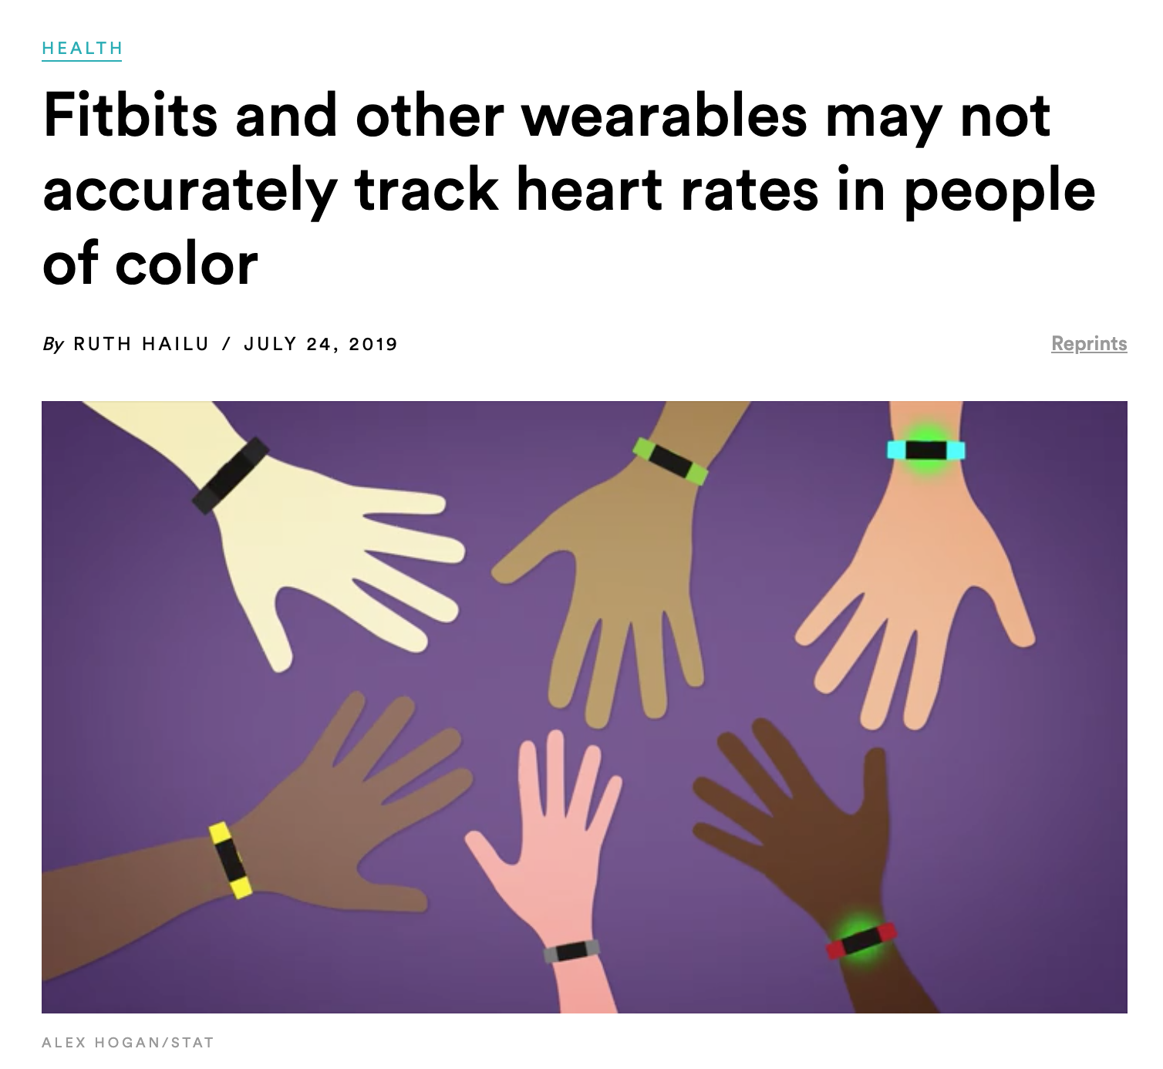
https://www.statnews.com/2019/07/24/fitbit-accuracy-dark-skin/
Notes:
Racial injustice across all races

Slide 6
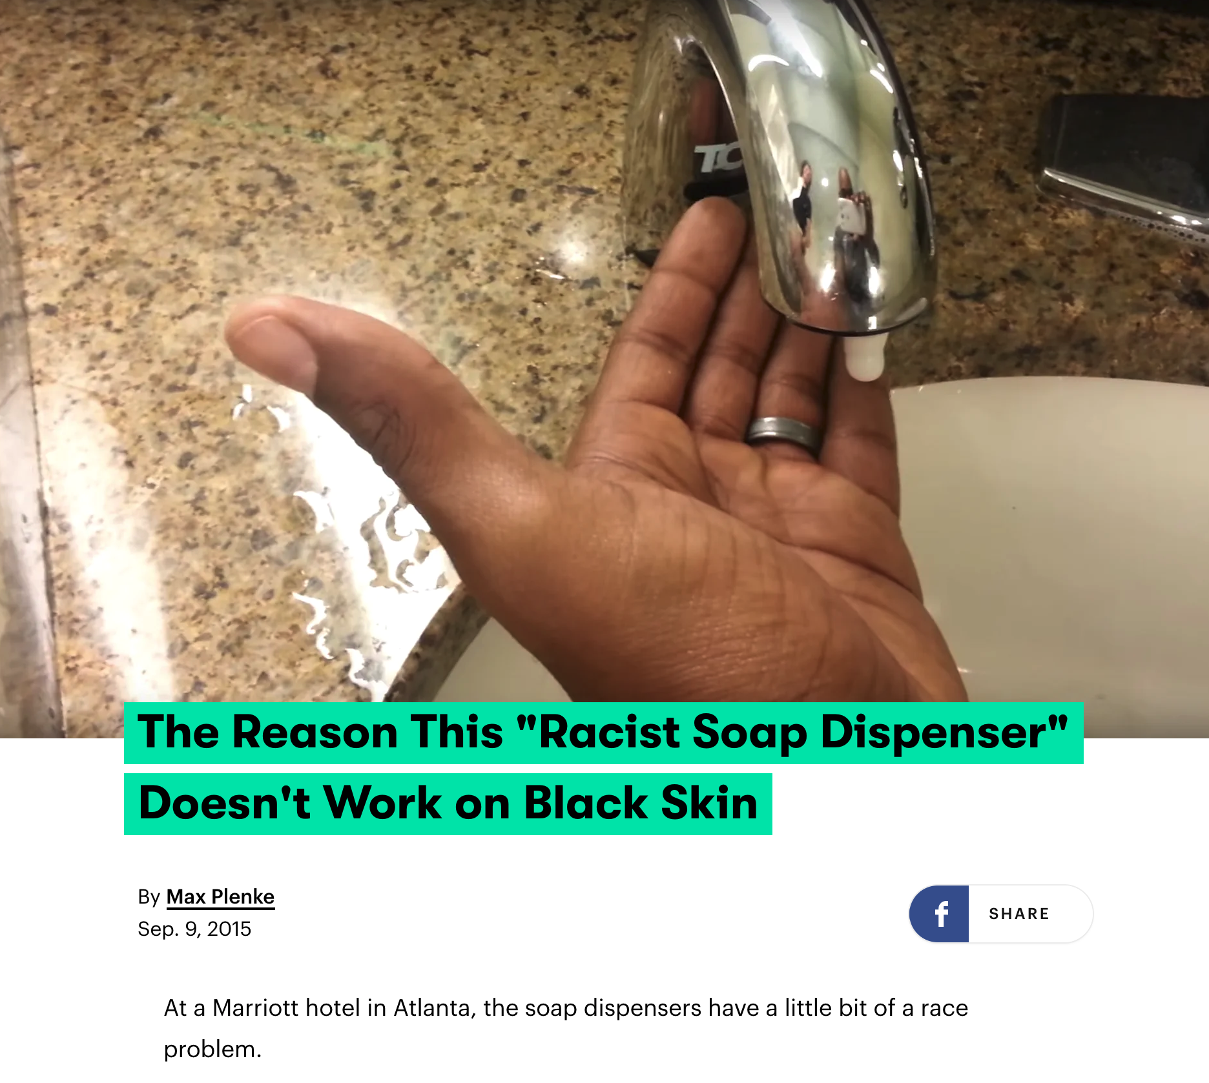
https://www.mic.com/articles/124899/the-reason-this-racist-soap-dispenser-doesn-t-work-on-black-skin
Notes:
Racial injustice across all races

Slide 7
Racial Injustice creates challenges
Segregated communities
Lack of quality living, finance and education
Biased recruiting
Society Stigma
Hatred and further divide
Products and design solutions geared towards the majority

Slide 8

Gender Equity
Photo by @gajus on Freepik

Slide 9
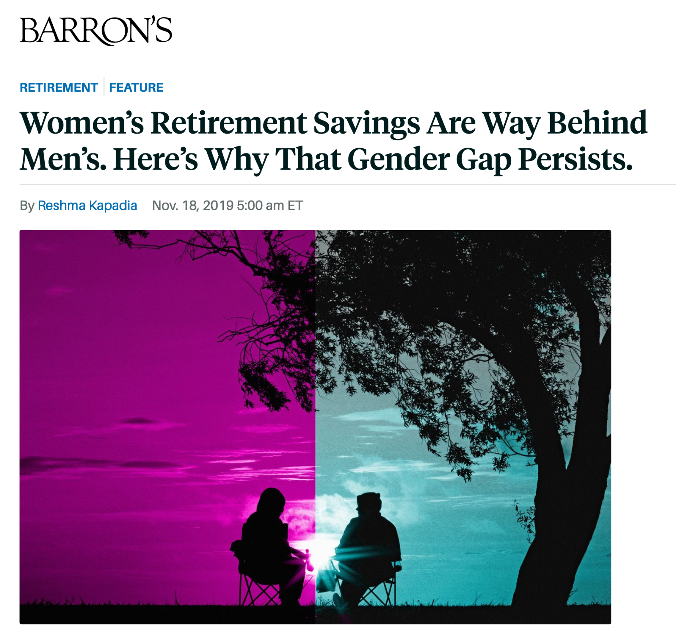
According to a new study from the Transamerica Center for Retirement Studies, both men and women’s median estimate for what they would need in retirement savings came to $500,000.
45% of women weren’t confident they would be able to retire comfortably, compared with 29% of men
Men were nearly twice as likely as women to have accumulated $250,000 or more.
https://www.barrons.com/articles/womens-retirement-savings-are-way-behind-mens-heres-why-that-gender-gap-persists-51574071201

Slide 10
Gender Gap
is a function of women, on average, earning less, taking breaks during their career for caregiving, not investing as often as men and living longer, which can drive up their long-term care costs versus men.
https://www.barrons.com/articles/womens-retirement-savings-are-way-behind-mens-heres-why-that-gender-gap-persists-51574071201

Slide 11

🏳️‍🌈 Sexual Orientation
Photo by @mego-studio on Freepik

Slide 12

Gender Identity
Photo by @rawpixel on Freepik

Slide 13
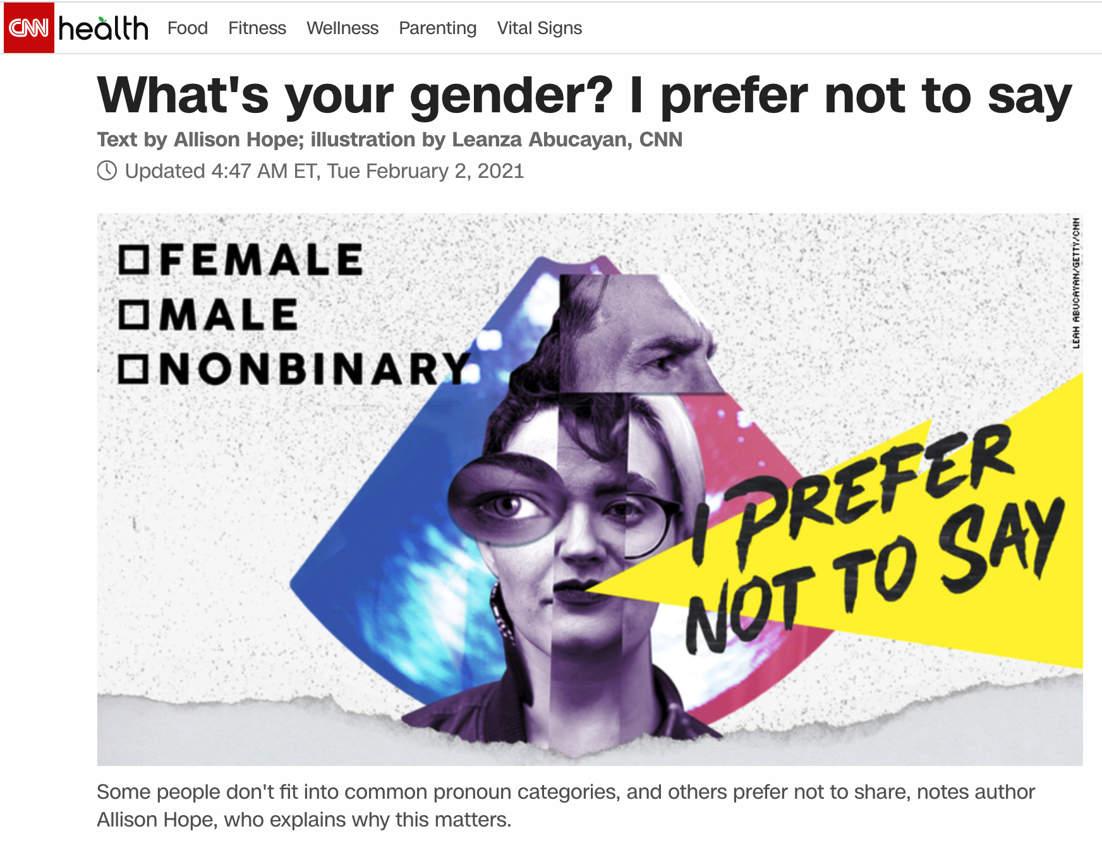
I prefer not to say.
"When it comes to filling out a form, I can write my name and address and birth date on autopilot without pause.
But when I get to the gender question, a wave of anxiety washes over."
CNN Health - https://www.cnn.com/2021/02/02/health/gender-question-not-always-necessary-wellness/index.html

Slide 14
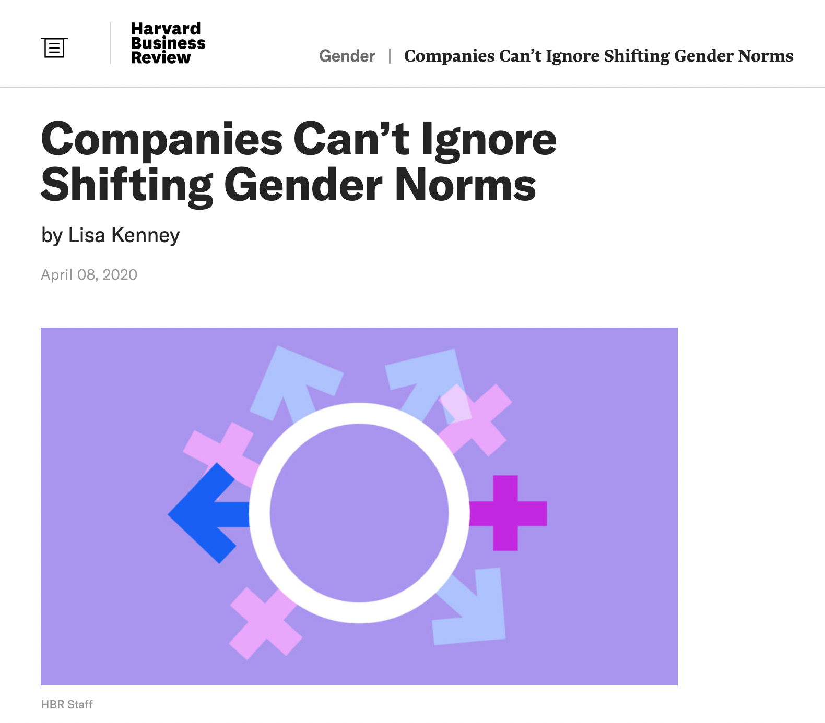
Generation
Over 12% of millennials identify as transgender or gender nonbinary and 25% of Generation Z expects to change their gender at least once in their lifetime.
Harvard Business Review - https://hbr.org/2020/04/companies-cant-ignore-shifting-gender-norms

Slide 15
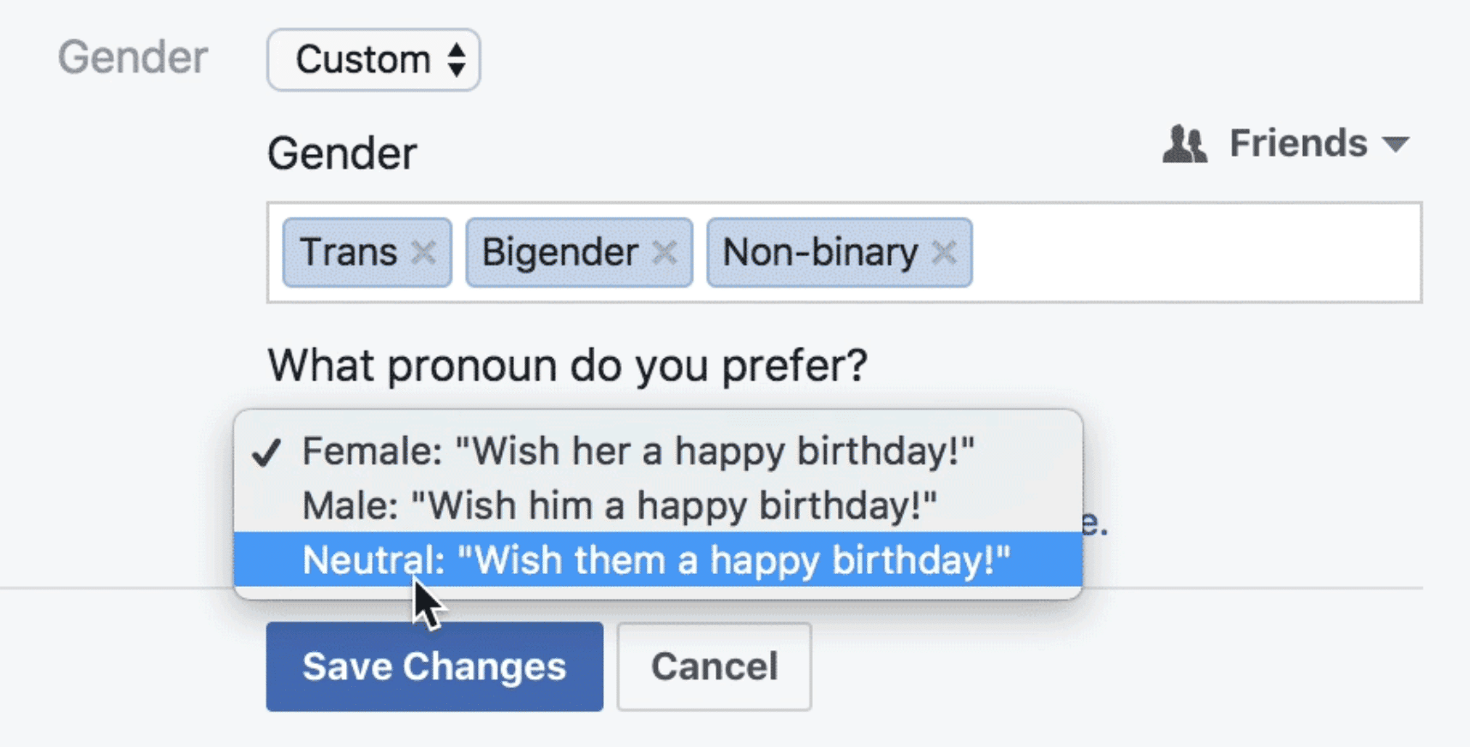
Facebook's 50+ custom gender options
It is often also acceptable to use the third person plural (they, them, their, themselves) instead of the third-person singular (he/she, his/hers, him/her, himself/herself) when referring to someone who has not expressed a clear pronoun choice.

Slide 16
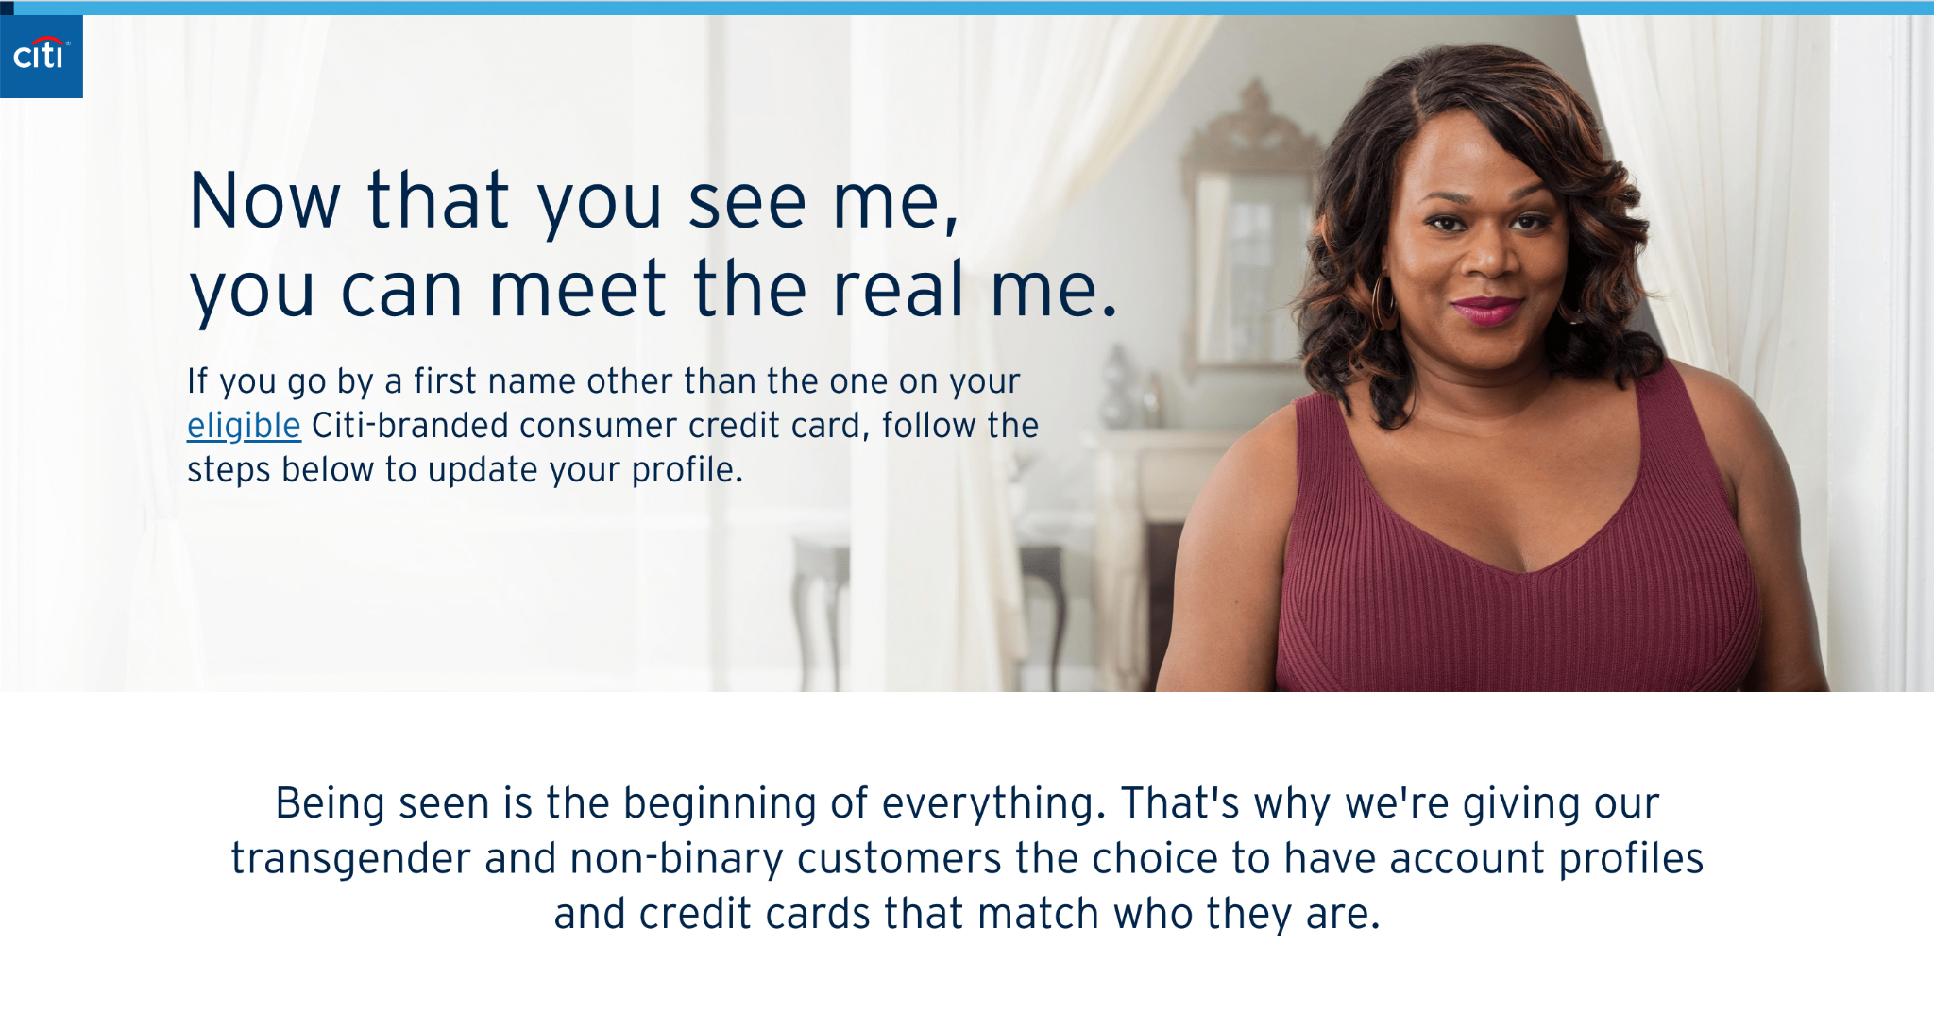
Citi - https://online.citi.com/US/JRS/portal/template.do?ID=update-my-name

Slide 17

Mastercard True Name - https://youtu.be/Oq8OsHeHtvM

Slide 18

Cultural &
Religious
Illustration by @kenchiro75 on Freepik
Notes:
needs around investing and decision making. lending practices: ETF having casino in their funds, or companies that which is against ethical religious principles

Slide 19
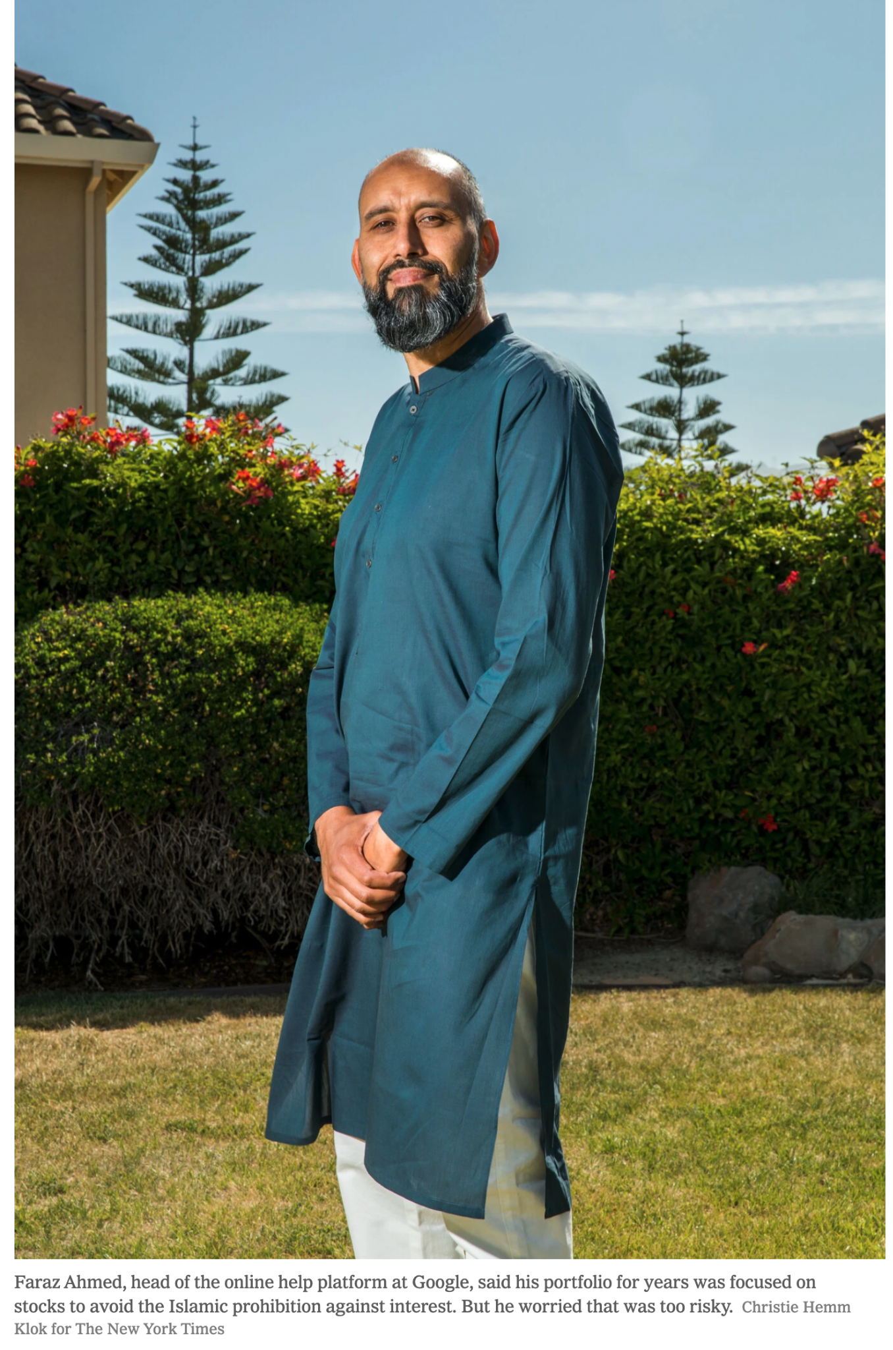
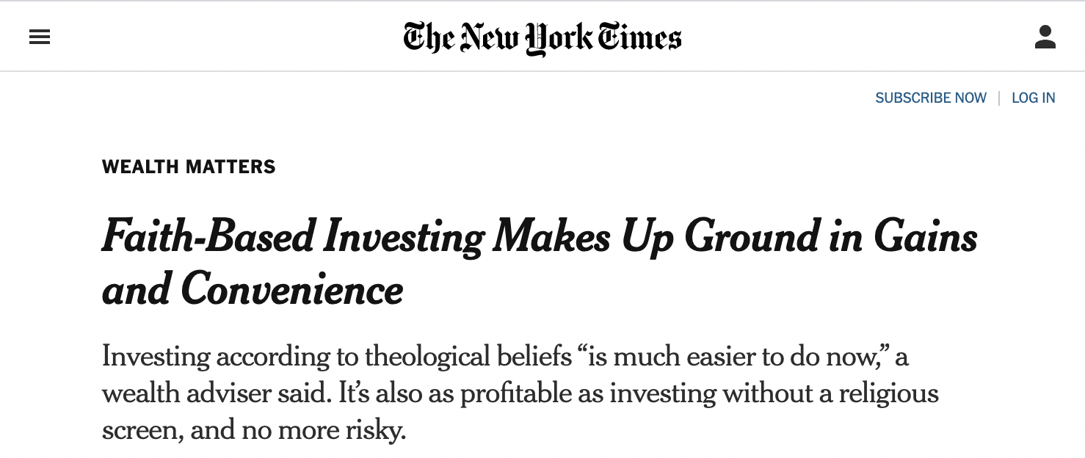
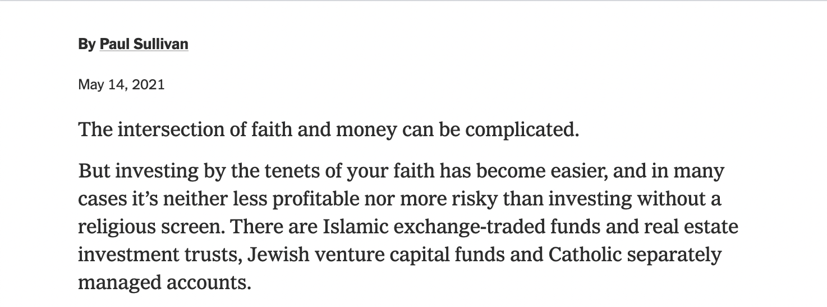
NY Times - https://www.nytimes.com/2021/05/14/your-money/faith-based-investing.html

